Slide 1
Introduction to Business Economics
Dr. T. Roja Rani
PhD, MBA, M.A.

Slide 2
Introduction
The word Economics has been derived from Greek word “IKONOMIKOS” which means ‘Laws of Households’.
In an economy, all the activities are divided into two categories: They are Economic Activities and Non-economic activities. All Economic activities revolve around the circular motion of wants – efforts – satisfaction and it happens because of scarce resources.

Slide 3
Definitions of Business Economics
According to Mc Nair and Meriam, “Business economics consists of the use of economic modes of thought to analyze business situations.”
Siegel man has defined Business economics as “the integration of economic theory with business practice for the purpose of facilitating decision-making and forward planning by management.”

Slide 4
Economics is related with micro economic concepts like demand, supply, cost, price etc. When we integrate such concepts of economics with business practice it is known as Business Economics.
It also relates with Macro Economic concepts like National Income, Inflation, Employment situation, Infrastructure facilities, which studies the economy as a whole.

Slide 5
Business Economics is the integration of two major concepts: Economic Theory + Business Practices. It helps in making the best decisions based on the analytical tools of Economic theories and best-suited Business Policies defined within Business Practices.
It is the application of economic theory and methodology to business.

Slide 6
Nature of Business Economics
Business Economics is a Science
It is a systematic body of knowledge which can establish a relationship between cause and effect.
Business Economics integrates the decision sciences with Economic Theory to help businesses to achieve their goals. Hence, it follows scientific methods and also tests the validity of the results.

Slide 7
It is Based on Micro Economics
Business Economics is more concerned with the decision-making process of individual establishments. Therefore, it depends on the techniques of Micro Economics.
It Incorporates Elements of Macro Analysis
All business firms aim for profits. The Macro economic concepts like Income level, employment situation and taxation policies also affects the firm. Therefore, a business manager has to take all such factors into consideration which may influence his business environment.

Slide 8
It is an Art
Business Economics is an art as it requires the practical application of rules and principles to achieve set objectives.
Pragmatic in Approach
Microeconomics is purely theoretical and analyzes economic occurrences under some assumptions. It tries to solve the problems which the firms face in the real world.
Interdisciplinary
Business Economics incorporates tools from many other disciplines like Traditional Economics, Mathematics, Statistics, Accounting, Marketing, Welfare Economics, Psychology, Sociology etc. Therefore, is interdisciplinary in nature.

Slide 9
Business Economics is Dynamic in its nature:
Business Economics deals with human-beings (consumers, producers etc.). The nature and attitude differs from person to person. Thus to cope up with dynamism and vitality, Business Economics also changes itself over a period of time.

Slide 10
Economic Theory – Positive and Normative.
A positive or pure science analyzes the cause and effect relationship between variables in a scientific manner. However, it does not involve any value judgment. In simpler words, it describes the economic behavior of individuals or society without focusing on the desirability of such behavior.
On the other hand, normative science involves value judgments. It suggests a course of action under the given circumstances.

Slide 11
Usually, Business Economics is normative in nature. It offers suggestions for the application of economic principles while forming policies, making decisions, and planning for the future. However, firms must understand their environment thoroughly to establish decision rules. This requires the study of positive economic theory.
Therefore, we can say that Business Economics combines the essentials of both the theories while keeping more emphasis on the normative economic theory.

Slide 12
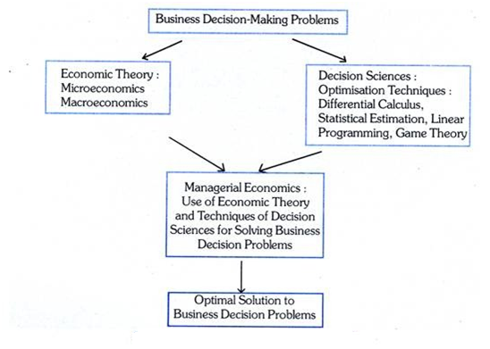

Slide 13
Scope of Business Economics
Business Economics covers most of the problems that a manager or establishment faces. Hence, the scope of business economics is wide. Since a firm can face internal/operational issues as well as external or environmental issues. Micro Economics helps with internal or operational issues whereas Macro Economics is applied to external or environmental issues.

Slide 14
1. Analyzing Demand and Forecasting
Analyzing demand is all about the changes in demand and the consumer behavior.
Demand Forecasting is a technique used to predict the future demand for a good or service. The accurate predictions help them produce the required quantities of goods at the right time.

Slide 15
2. Production and Cost Analysis
Production relates with What to Produce, how to produce and for whom to produce the output. Cost analysis, on the other hand, enables the firm to identify factors like output, time period, Cost of raw materials used, technology used etc. Further, by using both these analyses, a firm can maximize profits by producing optimum output at the least possible cost.

Slide 16
3. Pricing Decisions, Policies & Practices:
Pricing is an important area of business economics. We have to take correct pricing decisions, which creates revenue to the firm. Price Determination in Various Market Forms, Pricing Method, Differential Pricing, Product-line Pricing and Price Forecasting.

Slide 17
4. Inventory Management
Firms use certain rules to reduce costs associated with maintaining inventory in the form of raw materials, work in progress, and finished goods. Further, it is important to understand that the inventory policies affect the profitability of a firm. Hence, economists use ABC analysis and mathematical models to help the firm in maintaining an optimum stock of inventories.

Slide 18
5. Capital Management:
Various theories pertaining to capital and investments offer scientific criteria for choosing investment projects. Further, these theories also help the firm in assessing the efficiency of capital. Business Economics assists the decision-making process when the firm needs to decide between competing uses of funds.

Slide 19
6. Profit Management:
Profits depend on many factors like changing prices, market conditions, etc. The profit theories help firms in measuring and managing profits under such uncertain conditions. Further, they also help in planning future profits.

Slide 20
7. Risk and Uncertainty Analysis
Most businesses operate under a certain amount of risk and uncertainty. Also, analyzing these risks and uncertainties can help firms in making efficient decisions and formulating plans.

Slide 21
Role of Business Economist
In India, a Business Economist is expected to perform the following functions:
Macro forecasting for demand and supply
Production Planning
Economic feasibility of new production lines or new projects

Slide 22
Assistance in preparation of overall development plans.
Risk Analysis
Production Analysis
Capital Budgeting
Decision-making process.

Slide 23
Applications in Managerial Economics:
Demand Decisions
Input-Output Decisions
Price-Output Decisions
Profit related Decisions
Investment Decisions
Economic Forecasting and Forward Planning

Slide 24
Multidisciplinary Nature of B.E
Business Economics incorporates tools from many other disciplines like Traditional Economics, Mathematics, Statistics, Accounting, Marketing, Welfare Economics, Psychology, Sociology etc. Therefore, is multidisciplinary in nature.

Slide 25
Business Economics – Economics
B.E – Operations Research
B.E – Mathematics
B.E – Statistics
B.E – Accountancy
B.E – Psychology
B.E – Organizational Behaviour

Slide 26
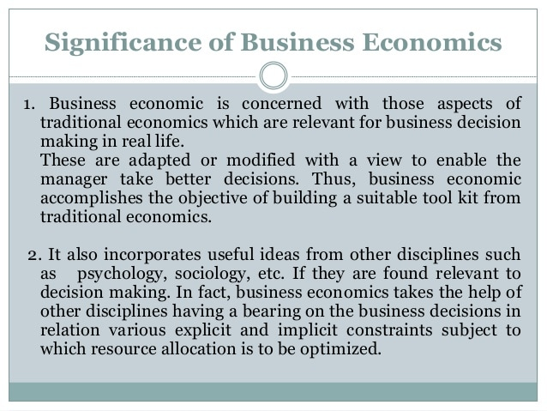

Slide 27
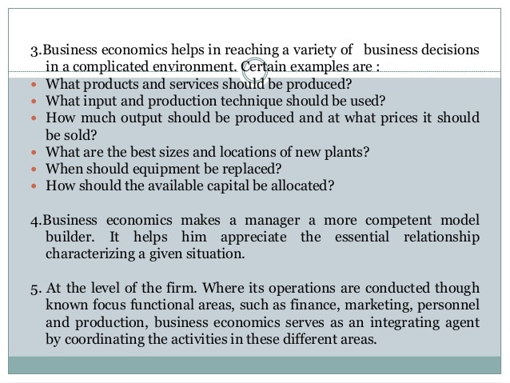

Slide 28
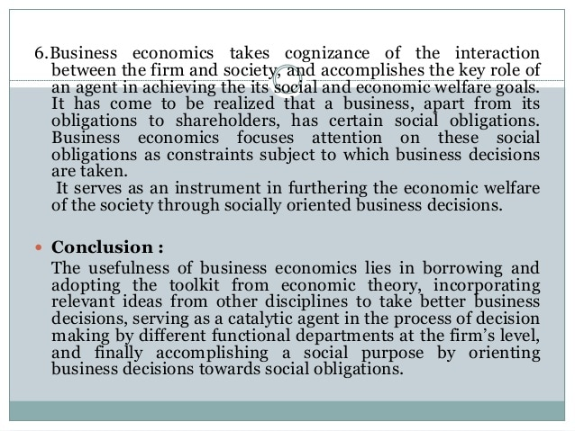

Slide 29
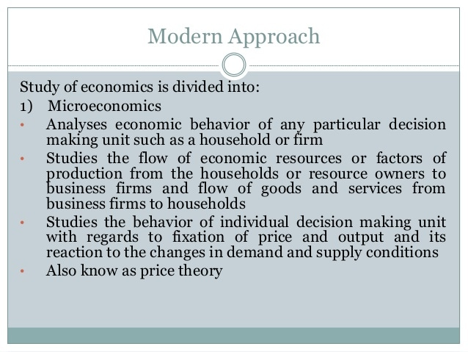

Slide 30
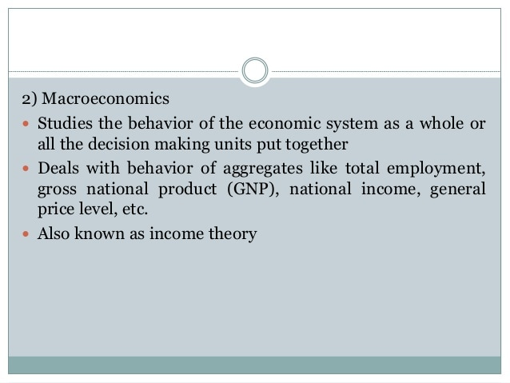

Slide 31
THANK YOU

